Slide 1


ANALYZING AMAZON SALES

Slide 2
1
INTRODUCTION
Sales management is essential for reducing costs and increasing profits in competitive markets. This project uses an Amazon dataset for ETL to analyze sales trends by month and year. Key metrics and attribute relationships are identified through this analysis. The insights help optimize sales strategies. Overall, the findings support better business decisions.

Slide 3
2
DETAILS OF DATA
Region
Order Priority
Units Sold
Country
Order Date
Unit Price
Item Type
Order ID
Total Profit
Sales Channel
Ship Date
Total Revenue

Slide 4
3
MAIN KPIS
- Total Cost
- Total Revenue
- Total Profit
- Total Revenue by Month
- Total Revenue by Year
- Top 5 Month-Year by Revenue
- Top 5 Products by Total Profit
- Online & Offline Order Sales

Slide 5
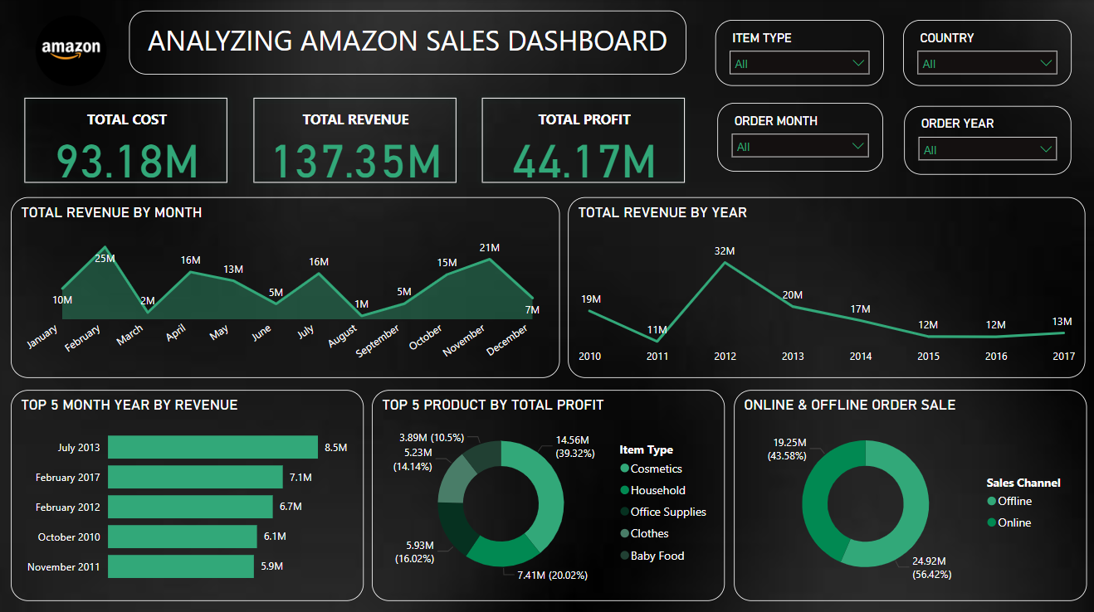
4
MY DESIGN

Slide 6
THANK YOU

